Slide 1
Coordinate Transformations
2D Coordinate Systems

Slide 2
2D Coordinate Systems
Before maps can be drawn, the positions, or co-ordinates, of the mapped points must all be in one single co-ordinate system. Thus if more than one co-ordinate systems are involved, they would need to be converted. To do that, one usually retains one co-ordinate system and converts all the positions which refer to all the other co-ordinate systems, to make them refer to the required system. This conversion is called a co-ordinate transformation.

Slide 3
2D Coordinate Systems
A 2-D co-ordinate system consists of an origin, two axes that intersect at that origin and either one or two scale factors. Examples of 2-D co-ordinate systems include: the UTM co-ordinate system, the co-ordinate systems on a digitizer, scanner and aerial photograph.

Slide 4
2D Coordinate Systems
ORIGIN
For the two dimensional system, the origin is defined by specifying its two co-ordinates (X₀, Y₀) for example, one along the first axis and the other along the second axis. These two co-ordinates are arbitrary but they are often taken to be equal to zero.
origins

Slide 5
2D Coordinate Systems
ORIENTATION
If the two axes are at right angles to each other, the system is called an orthogonal co-ordinate system. In rare cases, the angle between them is something other than 90 degrees. In this case the system is called a non-orthogonal system. If the axes are orthogonal, then defining the orientation of one axis would automatically define that of the other. Therefore only one angle is needed to define the orientation of a 2-D orthogonal co-ordinate system. If, however, the axes are non-orthogonal, then defining the orientation of one axis would not define the orientation of the other since the angle between them is unknown. Therefore two angles are needed to define the orientation of a 2-D non-orthogonal co-ordinate system; the orientation of the first axis and the angle between the axes.

Slide 6
2D Coordinate Systems
orientation

Slide 7
2D Coordinate Systems
SCALE
If a unit distance has the same length along the X as well as the Y axis, we say that the co-ordinate system has a homogeneous scale. In that case, knowing the distance of one line defines the scale of the system uniquely, no matter in which direction that distance extends. If, however, a unit length along the X axis is different from a unit length along the Y axis, then the 2-D system possesses two scale factors; S_{x} and S_{y} for example.

Slide 8
2D Coordinate Systems
The possible permutations for the definition of the 2-D co-ordinate system are therefore
TYPE OF 2-D SYSTEM
NUMBER OF PARAMETERS REQUIRED
SYSTEM
ORIGIN
ORIENTA-TION
SCALE
2-d non-orthogonal non-homogeneous scale
2
2
2
2-d non-orthogonal homogeneous scale
2
2
1
2-d orthogonal non-homogeneous scale
2
1
2
2-d orthogonal homogeneous scale
2
1
1

Slide 9
2D Coordinate Systems
DEFINING THE PARAMETERS
ORIGIN
The origin is usually arbitrarily defined. For example, the origin of a digitiser or a scanner is taken to be in one of its four corners and that of an aerial photograph system is usually at the intersection of the tic marks.

Slide 10
2D Coordinate Systems
ORIENTATION
The orientation may be either arbitrary or physically meaningful, A chain line and offsets is an example of an arbitrary orientation in a co-ordinate system. In this situation, the surveyor chooses one line, usually a boundary line to be an axis of the system and then defines the other axis as being orthogonal to it. A physically meaningful choice of orientation may be the axis of a digitiser or a scanner co-ordinate system being parallel to its two edges. The axes of the UTM system are also attached in some way to the actual north-south direction on the Earth surface.

Slide 11
2D Coordinate Systems
SCALE
The scale factor must be defined or may be determined by computing from known distances on the projection and the corresponding distances on the ground.

Slide 12
2-D Conformal Coordinate Transformation
2-D CONFORMAL TRANSFORMATION
A 2-D conformal transformation is a scale homogeneous, orthogonal transformation requiring 4 parameters – 1 scale, 1 orientation, 2 translations
Consider a line AB on 2 superimposed coordinate systems
The coordinates of the points A and B are known on both systems
E_{B}
B
Coordinate system 2
N_{B}
R
A
Coordinate system 1

Slide 13
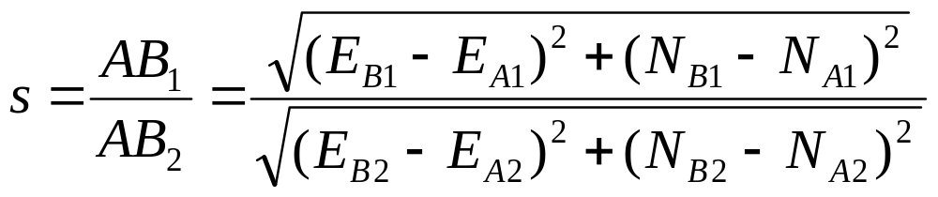
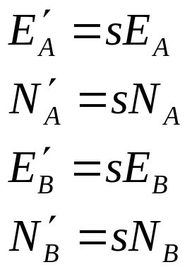
2-D Conformal Coordinate Transformation
The scale or units of measurement on the 2 systems are different.
To transform from system 1 to system 2 the scale must be found
The scaled coordinates of the points in coordinate system 1 to coordinate system 2 are:
Any point on system 1 can be scaled to system 2

Slide 14
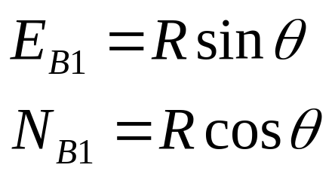
2-D Conformal Coordinate Transformation
The orientation of the 2 systems are different
Coordinate system 2
E_{B}
B
N_{B}
R
θ
Coordinate system 1
A
Consider point B

Slide 15
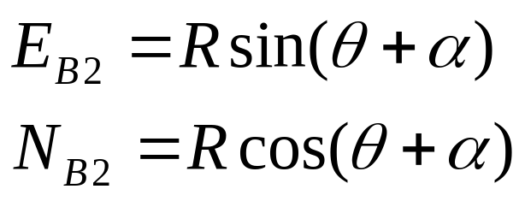
2-D Conformal Coordinate Transformation
On coordinate system 2 the same point B
Coordinate system 2
B
E_{B}
N_{B}
α
θ
R
A
Coordinate system 1

Slide 16
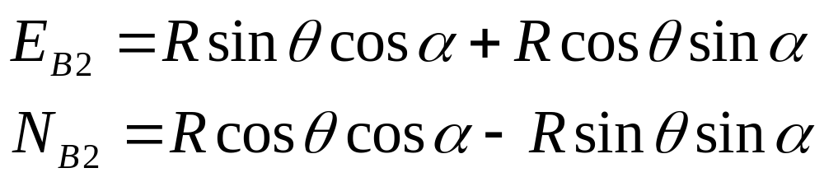
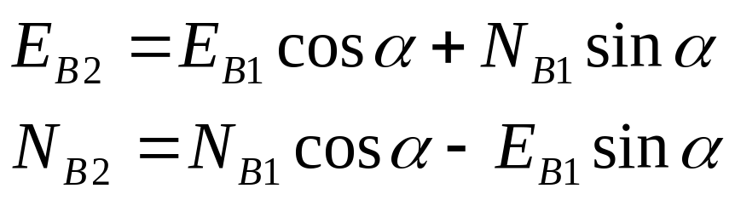
2-D Conformal Coordinate Transformation
Expanding using sum of sines and cosines
since

Slide 17
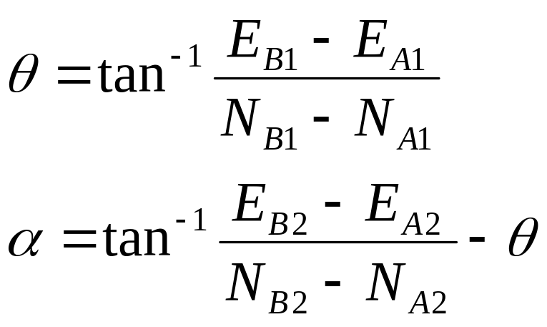
2-D Conformal Coordinate Transformation
The angles θ and α can be found by

Slide 18
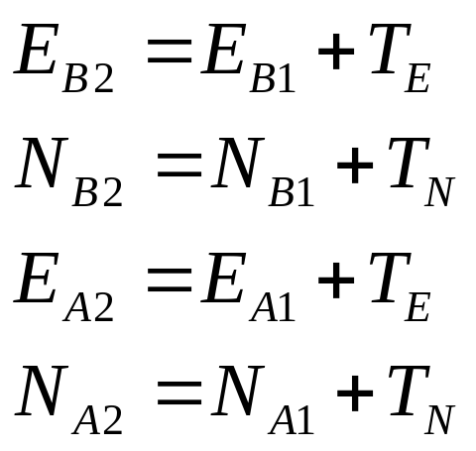
2-D Conformal Coordinate Transformation
A translation is required since the origin of the 2 systems are different
Consider the situation where the origins are shifted
B
Coordinate system 1
X₀, Y₀ (T_{E}, T_{N})
Coordinate system 2
(0, 0)

